Slide 1
Cognitive Modelling of human and LLM data
Hot Models

Slide 2
Do humans and LLMs solve problems differently ?

Slide 3
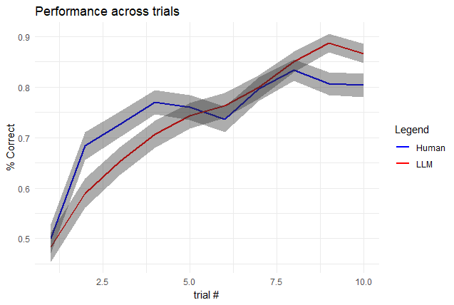
Notes:
humans have a high rate of learning at first then after trial 3-4, rate of learning reduces significantly and plateaus what kind of model might fitwell?
LLMs learn more “traditionally” - a traditional linear model might fit well?

Slide 4
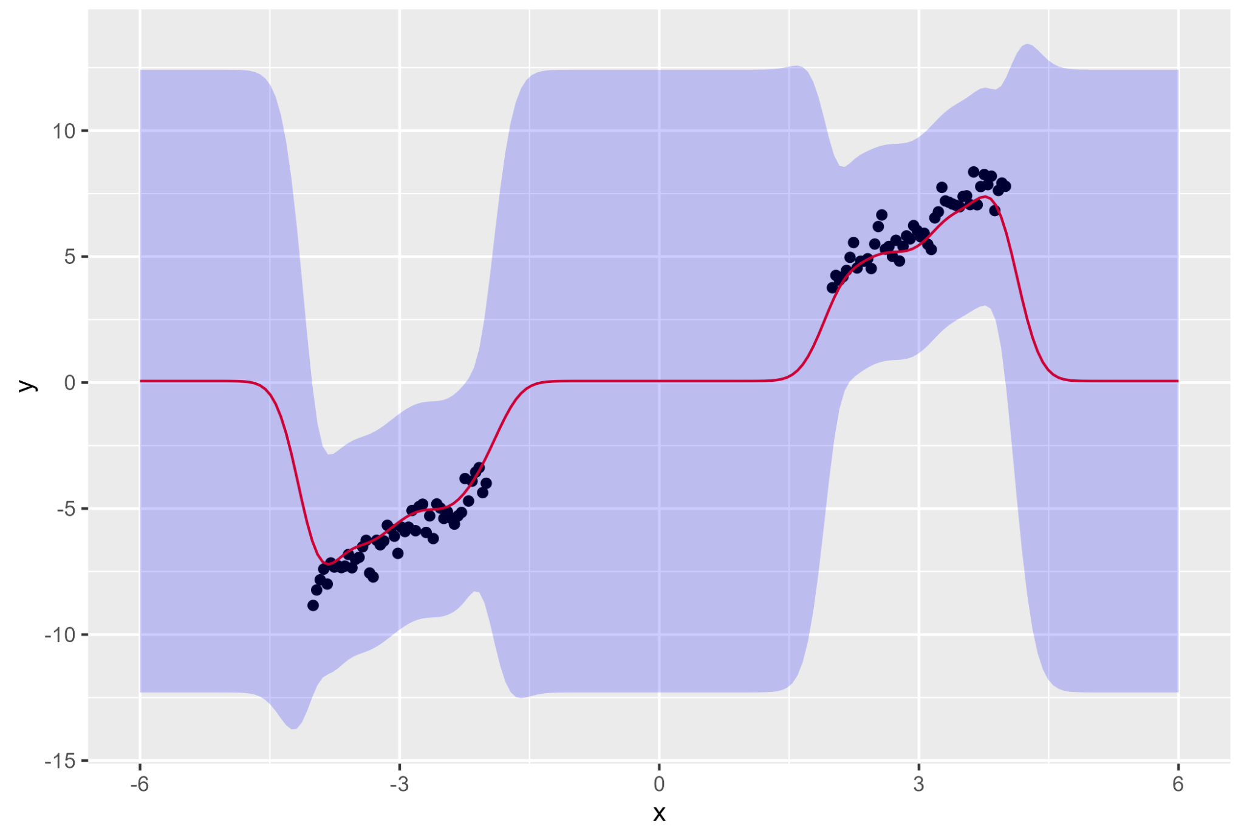
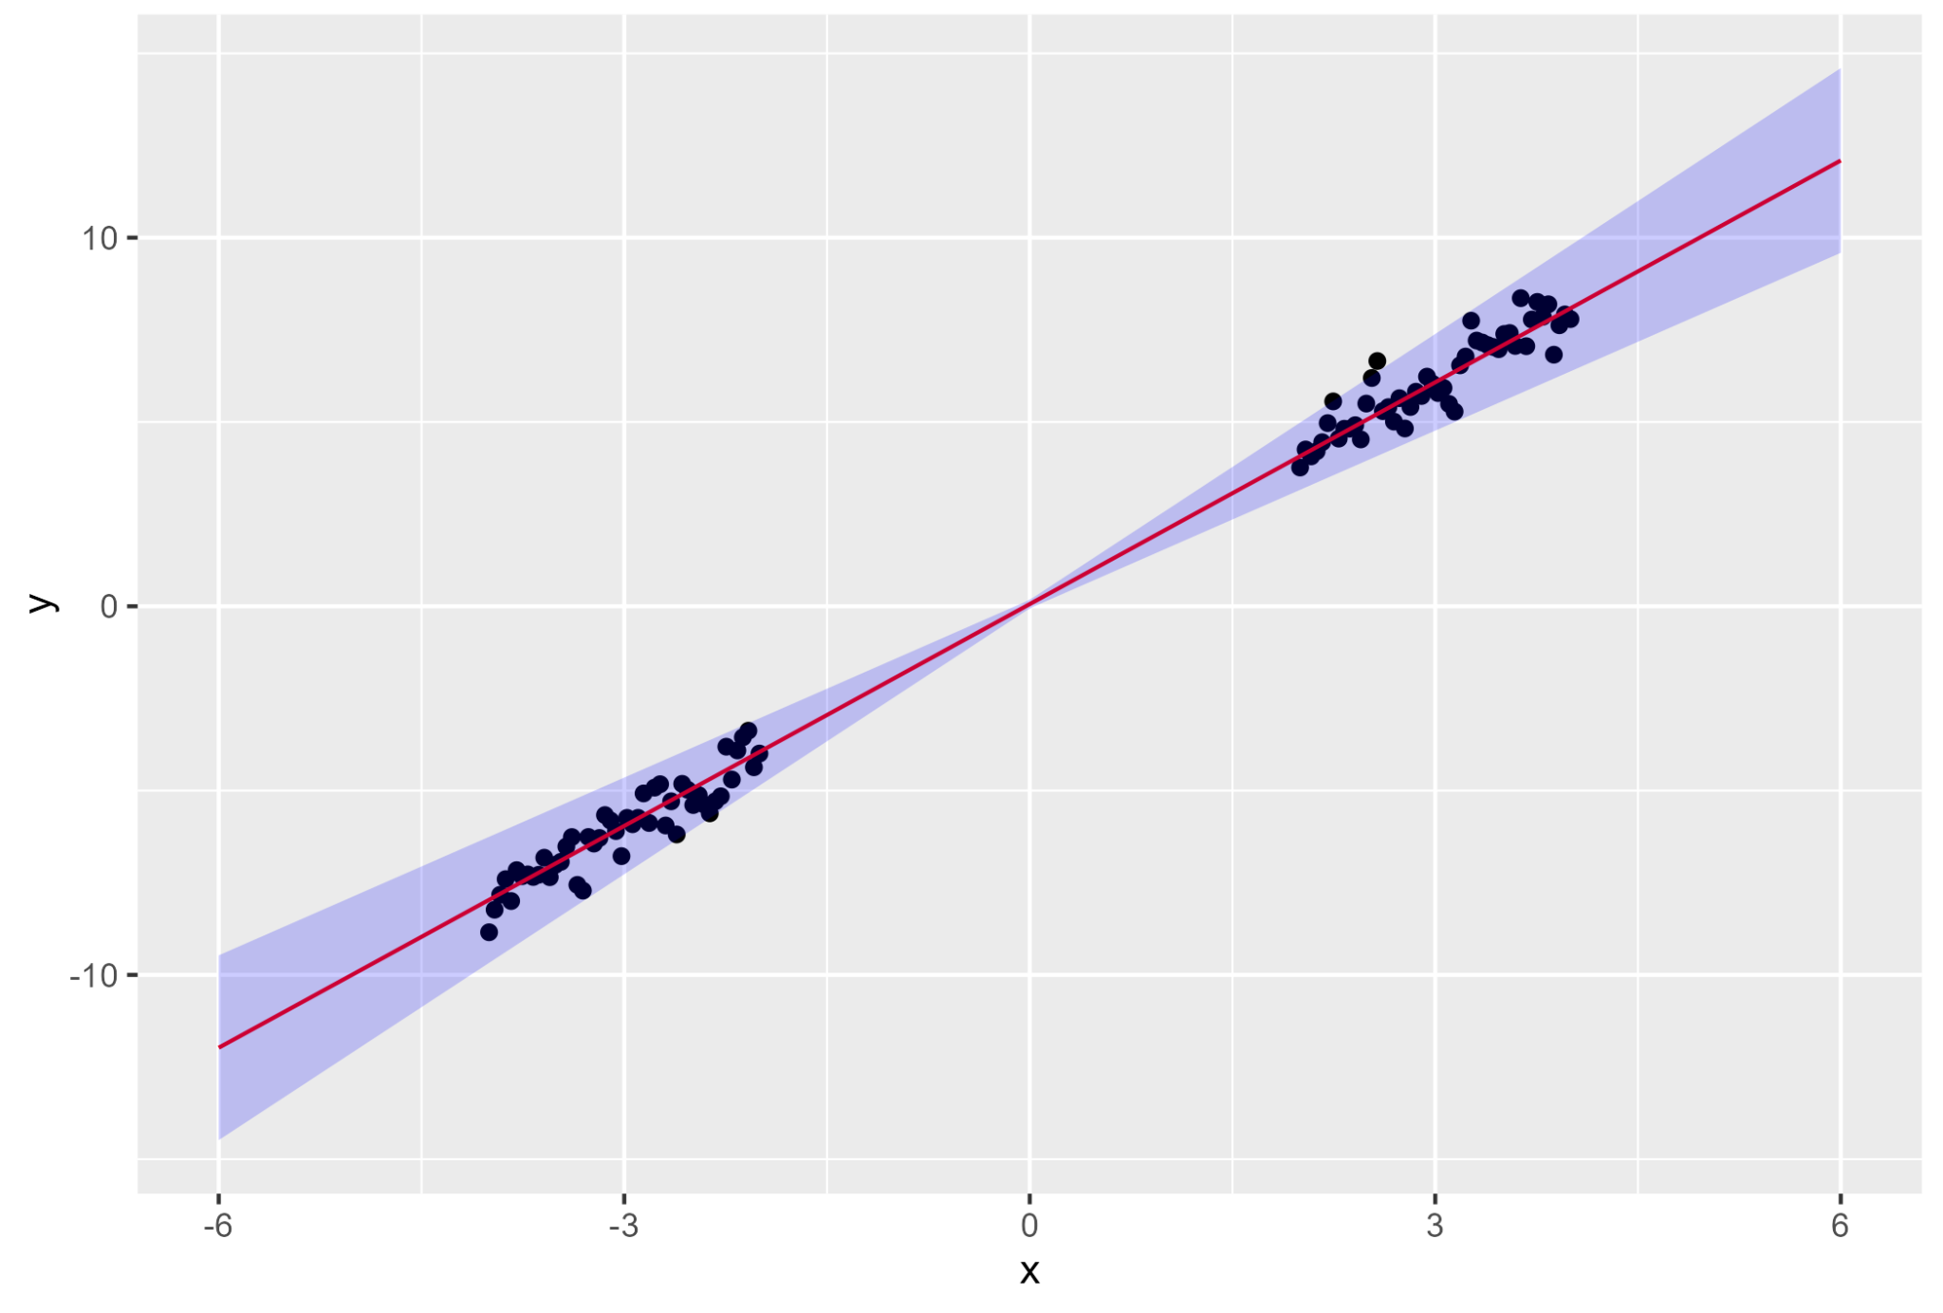
Function Learning Hypothesis
Gaussian Similarity Model
Linear Regression Model
- A good model for humans
(Schulz et al., 2018; Stojic et al., 2020)
- Rule-based, “true” model for the task
- LLMs?
Notes:
function learning means that how agents learn the relationship between input and output.
human function learning is said to be like Gaussian similarity model, which learn from the data points about their neighborhood
There is another model for function learning, not Gaussian but rule-based ones. so we used linear regression for the alternative.
so our problem is humans must learn like Gaussian but what about LLMs?

Slide 5
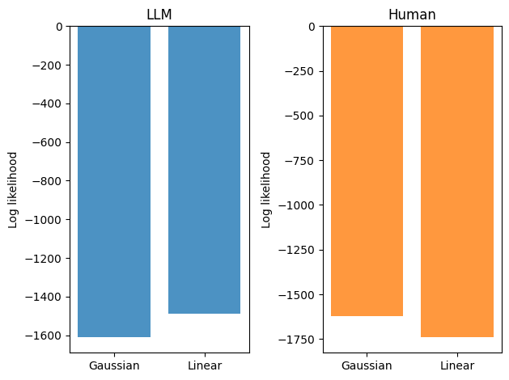
LLMs are more like linear models,
different from humans

Slide 6
Fitting the human behavioural responses

Slide 7
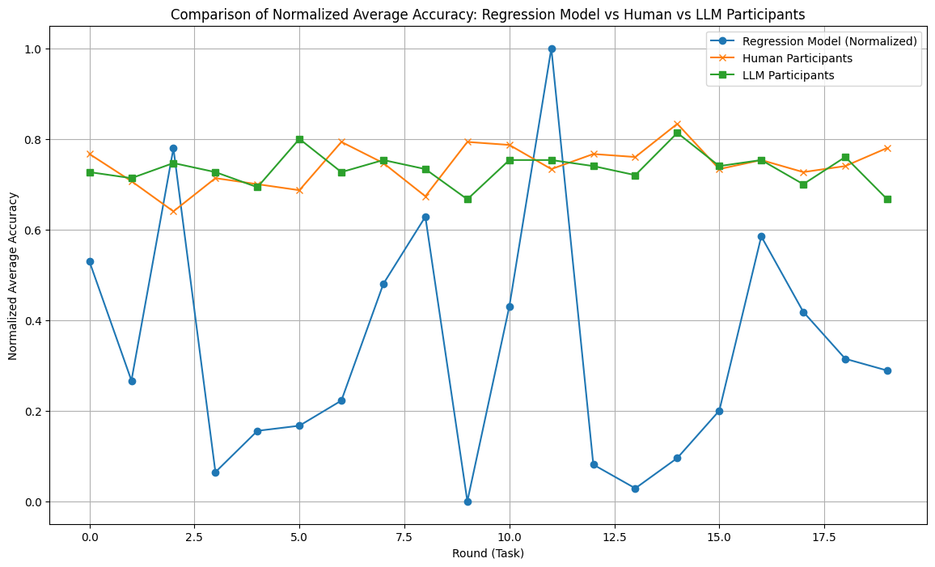
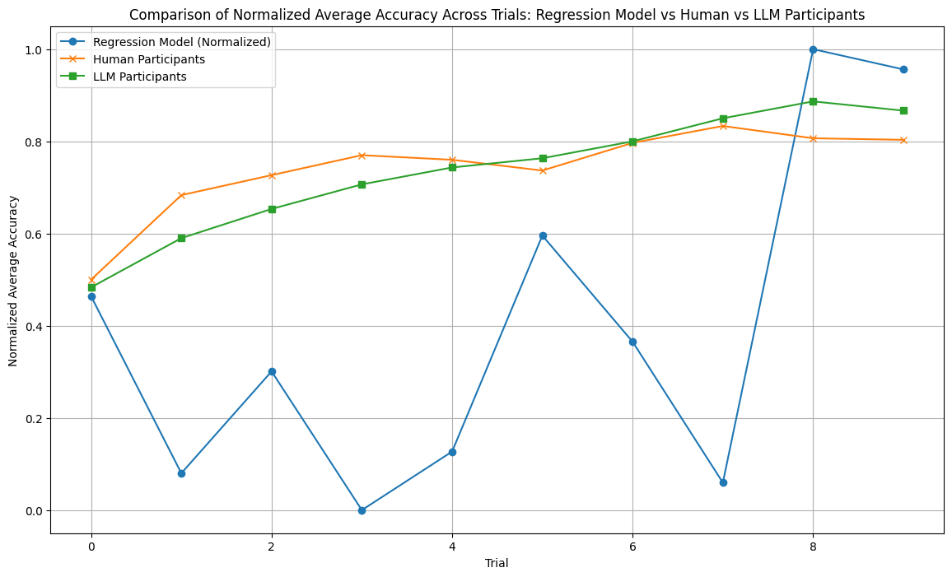
Linear Regression Model

Slide 8
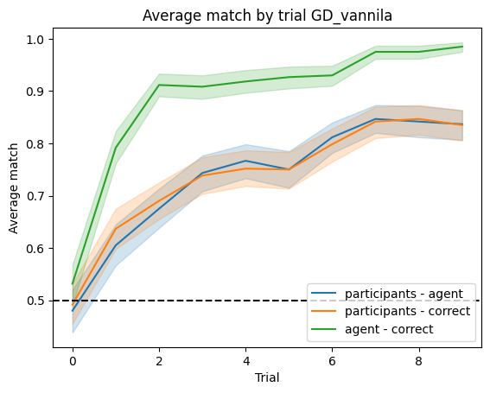
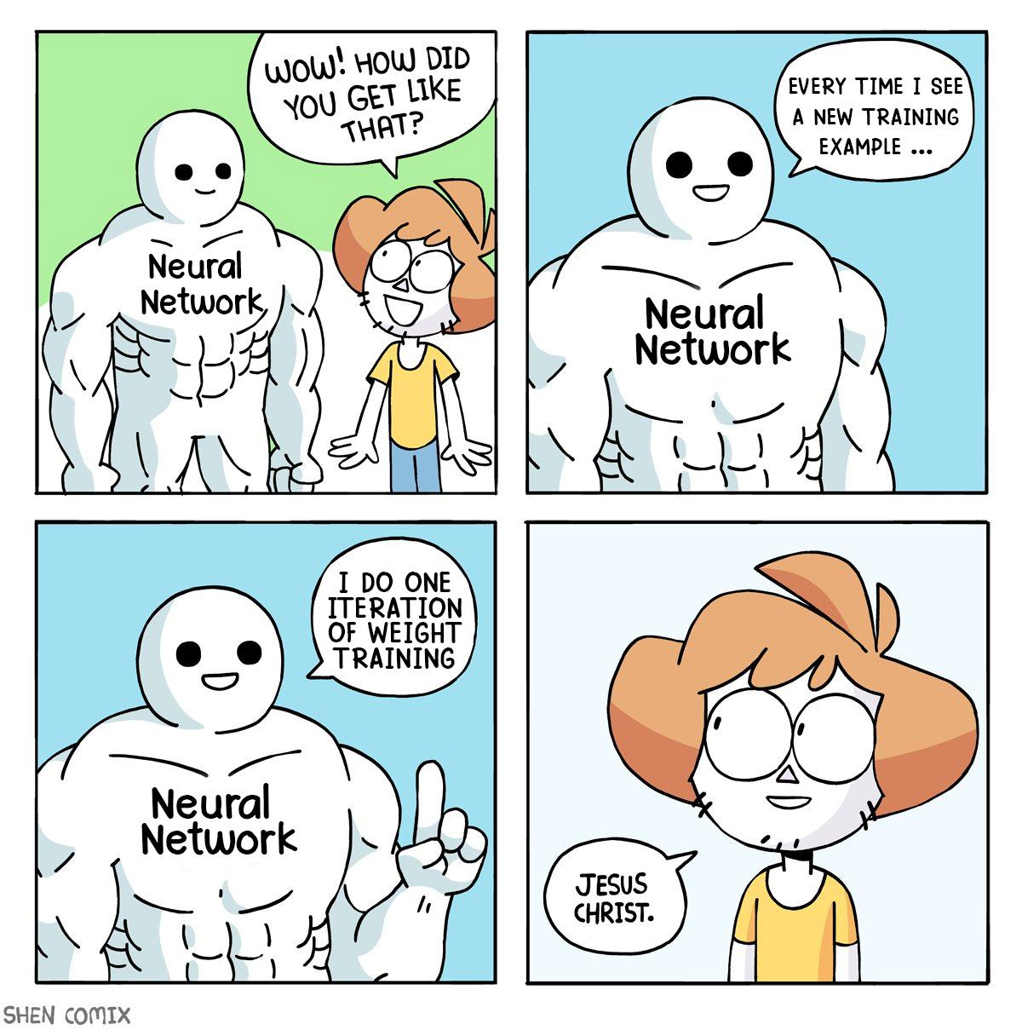
Gradient descent model

Slide 9
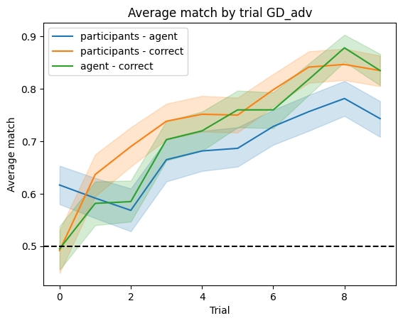
Gradient descent model (new and improved?)
Notes:
we reduced learning rate and frequency of updates near the end of the trials
we initialised to more ‘intuitive’ weights from our solving process (as shown in the high blue line at start)
we bounded the precision of weight updates as humans are not able to calculate gradients to 9 decimal places

Slide 10
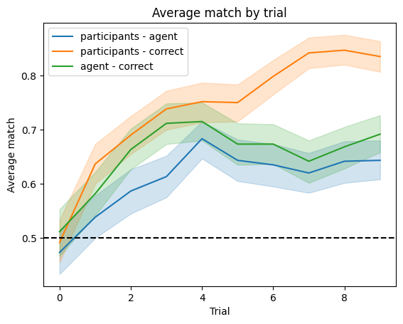

Rule-based model
Notes:
Starts from the intuition of our own play
prioritize features
first look at one feature, and if there is large difference favoring one monster, choose the monster. If there is no big difference, see the next feature
How to learn?: if made mistakes, change its prioritized features, and randomly reset if the smaller or the larger feature is favorable

Slide 11
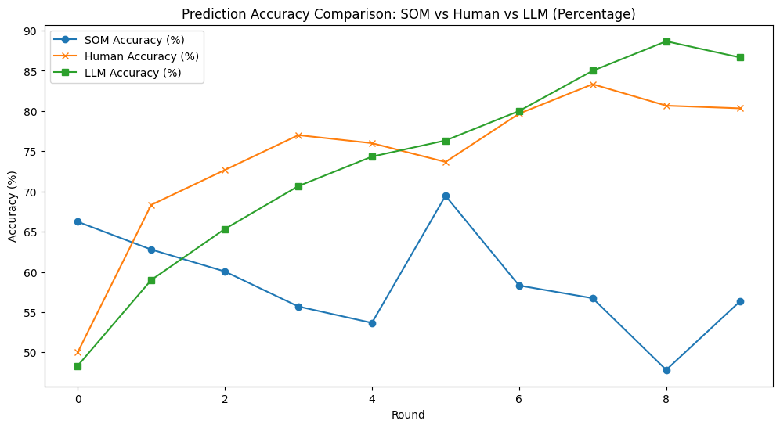
Self-Organizing Map (SOM)
ANN trained using competitive learning
Strong biological inspiration
Clustering, but picked because it selects well for low-dimensional datasets, projecting onto 2D map of proximal clusters and uses a ‘winner-takes-all’ neuron selection process
The goal of learning in the SOM is to cause different parts of the network to respond similarly to different, repeated stimuli

Slide 12
Thank you for your attention!
Hot models:
Yuki Tsukamura
Ryutaro Mori
Max Gupta
Niranjan Rajesh
Jovan Hussan
Tin Mišić

